Slide 1

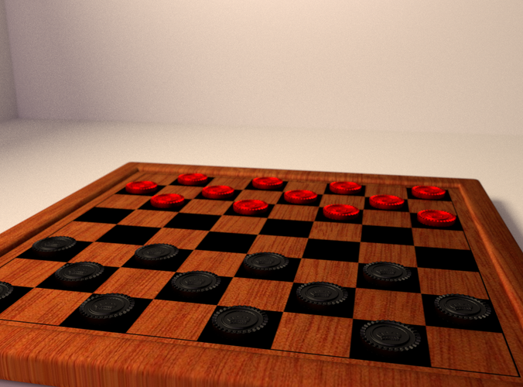
Ultimate Board Game
Garav Soni

Slide 2
Summary
Why?
Diagram
Demo
Problems
Next Steps
Q&A

Slide 3

Why?

Slide 4
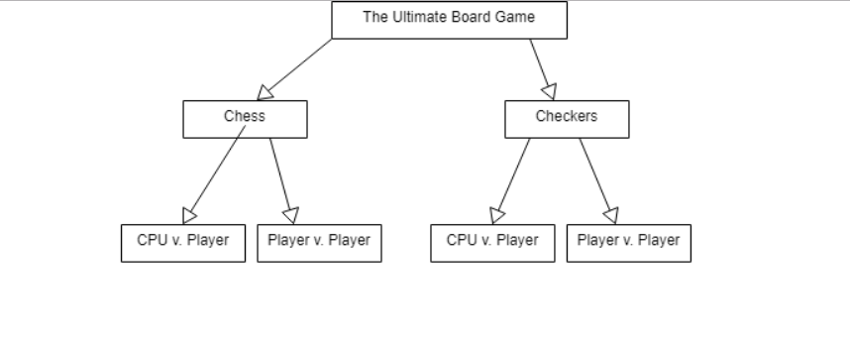
Diagram

Slide 5

Demo

Slide 6
problems
No JavaScript
Adding more features to the game

Slide 7
Next Steps
Add JavaScript
More interactive

Slide 8
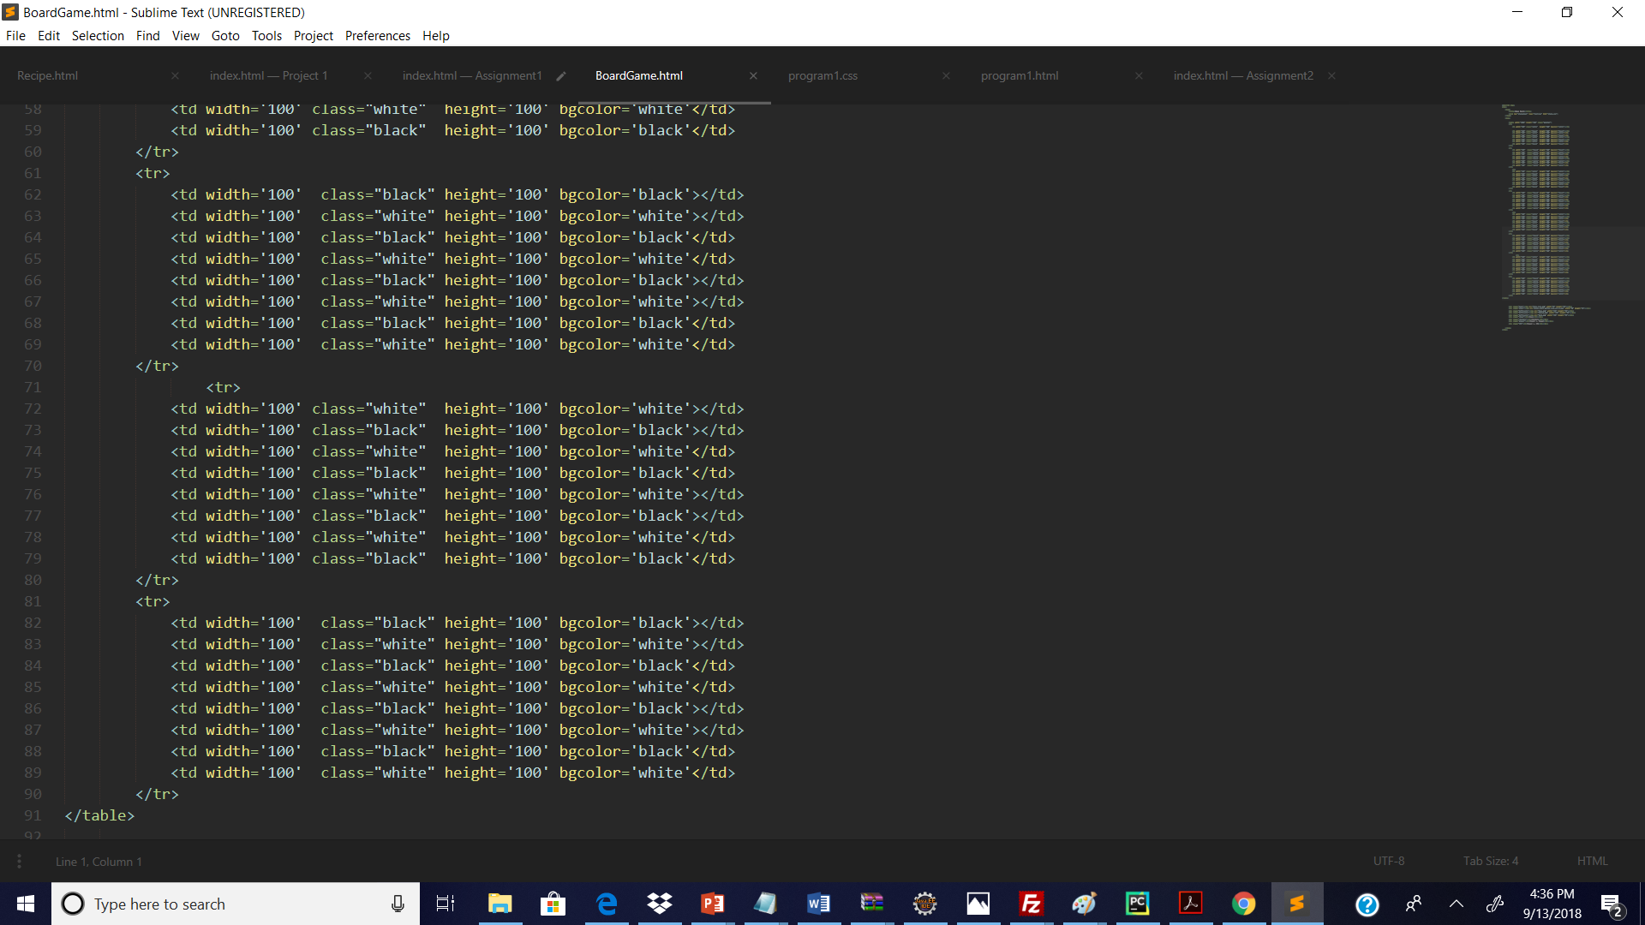
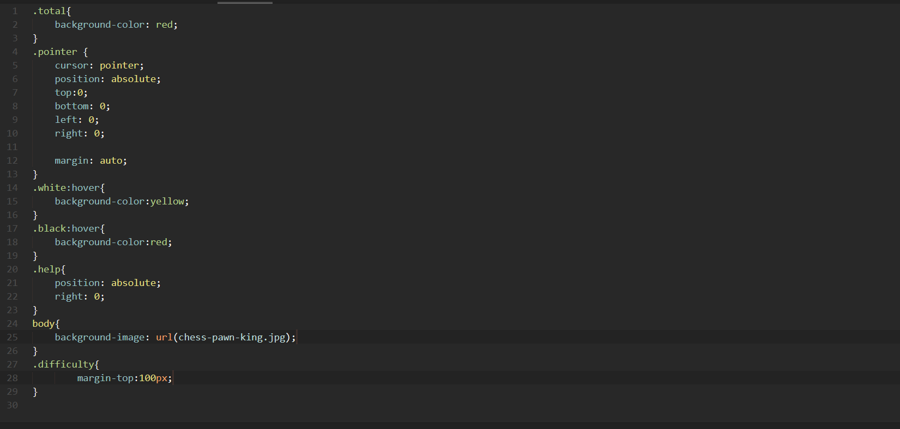
Code

Slide 9
Q&A

